Slide 1
team FOOTBALL
Pre-Summer Meeting
Parent Meeting

Slide 2
Why Are We Here
Prep For Camp
Fundraising update
Summer Schedule
Athlete and Parent Rules
Election of Sun Devils Club Officers
Plans
Homecoming
Senior Night

Slide 3
Prep For Camp
Utah St. University or Colorado Mesa
Leave @ 6am Wednesday morning
Return 9pm Sunday night
What to bring:
See Handouts
Questions?

Slide 4
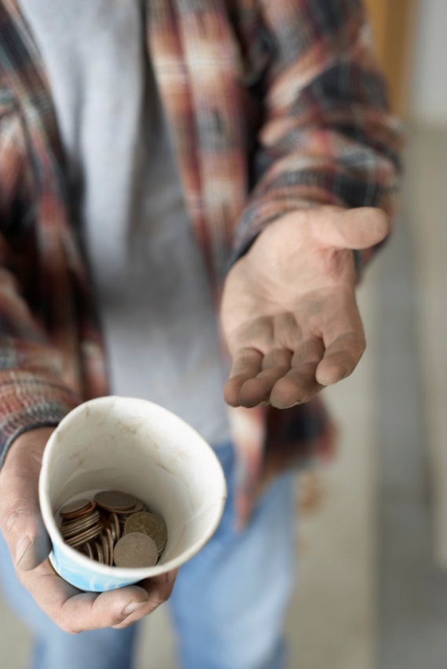
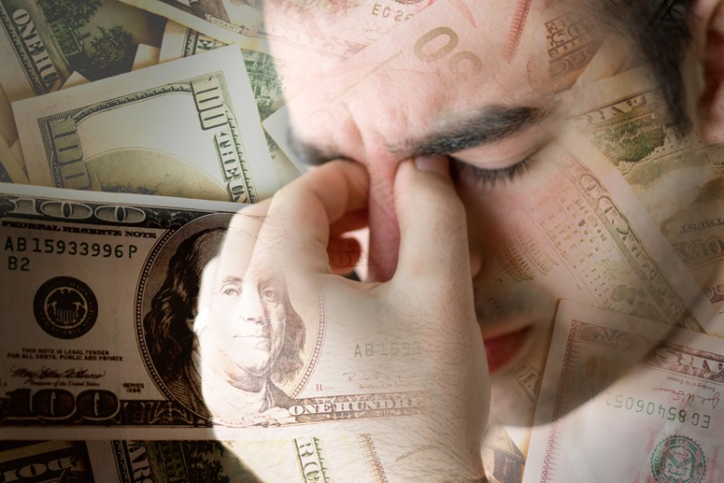
Fundraising
The Fun and Wonderful and Stressful world of Fundraising

Slide 5
Fundraising Goals
Main Goal: $60,000 (No I’m not kidding)
Where are we now?
Every Athlete Raise $650

Slide 6
Where are we Now?
Fruit Sales
ESPN Mags
Donation Letters:
Banners:
Program Ads:
Discount Cards:
Youth Concession Stand:
Season Concession Stand:

Slide 7
Summer Practice
Varsity & JV
July (Only)
5:30-7pm
Freshmen
Freshmen Camp (June)
6/22 to 6/26
5:30pm to 7:30pm
July (Only)
6pm-8pm

Slide 8
2 A Days
August
Equipment Hand Out
Varsity 8am 8/
JV 8am 8/
Freshmen 10am 8/
Practice (7 Days)
1st practice (More Physical Practice)
6am-8:30
Hour Break (Coaches will Sell PP&J, snacks and drinks for $1
2nd practice (Learning Practice)
9:30am-11:30

Slide 9
Concession Stand (continued)
Dates for Home Events:
Scrimmage
Home Games
Jr. mascot Games
Intra-squad Game
Please sign up for at least one event!

Slide 10
Athletes Handbook
Purpose of this is to inform you of my expectations:
Don’t be enablers
Please plan around the Football Calendar
Dr. Appts, watching my sibling, family day are not reasons to miss practice. (All will be unexcused)
Please reinforce the importance of going to school and practice everyday.
Communicate if your son will be absent with a simple text or email.
Bottom Line is if we don’t hold this standard we will never improve.

Slide 11
Parent Code of Conduct
Remember you represent you son
The way you act can be embarrassing
Remember the Coaching staff works hard
We spend more time with your kids then our own so please give us a break and let us coach
We want and need your support
Remember you don’t know who you are sitting around
Criticizing other players on the field have respect for others
Team mates support each other, they don’t drag each other down.

Slide 12
Spirit Pack/E-flier
Parent eflier will have Fan Apparel
Polo’s
Hoodies
Jackets
Sweat Shirts
Shirts
Anything Else?

Slide 13
Presale Merchandise
How many people would be interested in:
Hats and Visors?
$20 for Visor, $25 for the Hat
Hats Sizes: S/ M, L/ XL (Stretch fit)
Visor Size: One size fits all
Window Stickers
T-shirts
Hoodies

Slide 14
TEAM vs. TEAM Game
Intra-squad Coaches will coach and will hold a draft
Friday night
Senior’s & Juniors @ 7pm
Sophomores & Freshmen @ 5pm
Run just like a game
Will be officiated by Coaches
Nice way to get the boy’s into game mode
Concession stand will be open
Admission
$3 Presold (Sale starts Monday during lunch, ends Thursday)
$5 at the gate

Slide 15
Website
www.TEAMfootball.com
What’s on there:
Forms, Schedules
Photo’s
Communication forum
Donation Forum (Under construction)
Ordering Fan Gear (Under construction)

Slide 16
Welcome to the MASCOT Club
President
Run Organization
Hold meetings
Ensure all moneys go through HC
Find Sponsors and ways to raise money
VP
Organize Concession stand schedule for Jr Program and HS games
Coordinate Team Dinners
Find Sponsors and ways to raise money
Secretary
Track all inventory in concession stand
Track and record all proceedings at meetings
Treasurer
Collects all moneys generated from donations and concession stand sales
(Saturday’s Present Officer will assume this responsibility)

Slide 17
MASCOT Club What do we do?
Create Ways to fundraise in addition to what already being presented to the athletes.
Aide with Banner and Program ad sales
Work the concession stand
Create a shift schedule
Stock concession stand (Save receipt, turn in to HC)
Provide Team Meals (Cost effective)
Varsity pregame (Friday)
JV pregame (Thursday)
Freshmen postgame (Thursday after Freshmen game)
Meet with HC every Thursday
Discuss ideas for fundraising
Issues in the program
*Will not discuss strategy or playing time!

Slide 18
Key Information
Coach Sevier’s Contact Information
Cell (702) 600-0641
Office (702)
Email dpsevier@interact.ccsd.net
Parents please email me with contact information so I can update you monthly!
Parent support is need to build this program!

